Slide 1
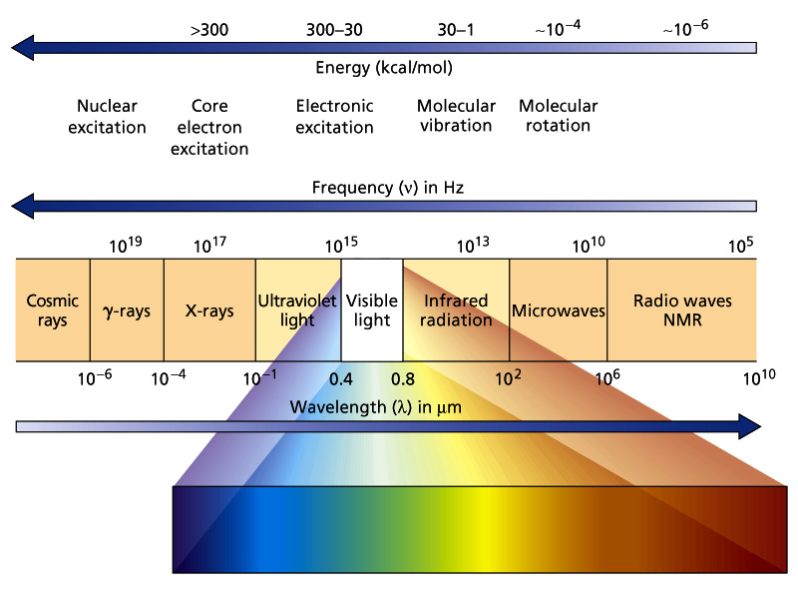
Electromagnetic spectrum

Slide 2
Electromagnetic Radiation

Slide 3
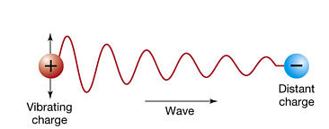
© 2005 Pearson Prentice Hall, Inc
If a charge moves nonuniformly, it radiates

Slide 4
Electric field at a large distance
Magnetic field

Slide 5
Total energy density of EM waves at a given time instance
Energy Density: Energy per unit volume

Slide 6
Average Energy Density

Slide 7
Take home message
Accelerating charge gives rise to radiation
Sinusoidal motion of charge gives rise to electromagnetic radiation gives rise to plane electromagnetic wave at a large distance.
The direction of electric field, magnetic field and propagation are mutually perpendicular to each other.
Electric and magnetic fields are in phase.
Energy of EM wave is equally distributed in electric and magnetic field components

Slide 8
Reflection and Refraction of Electromagnetic Wave

Slide 9
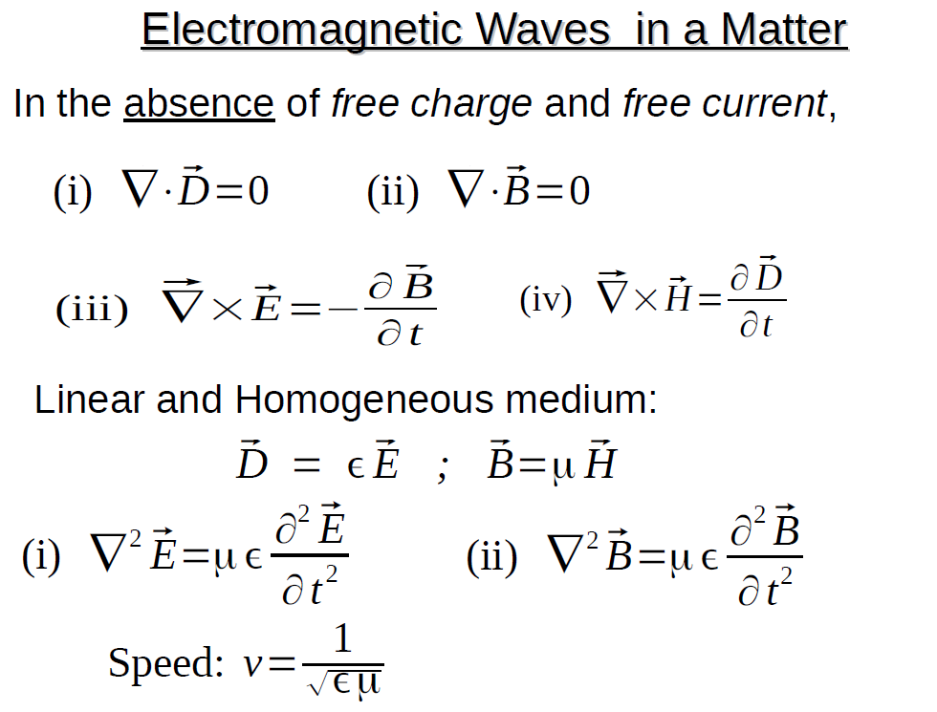

Slide 10
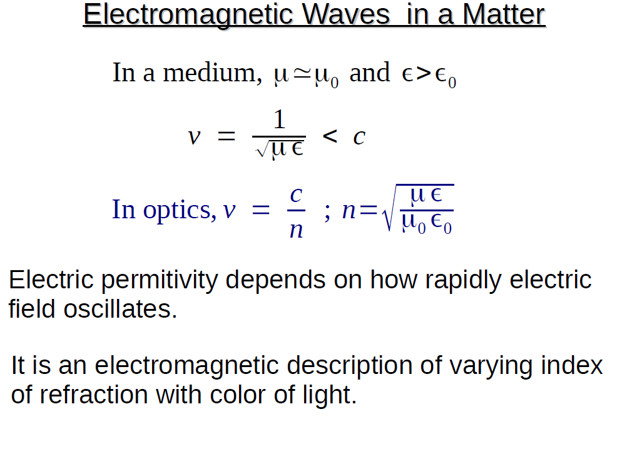

Slide 11
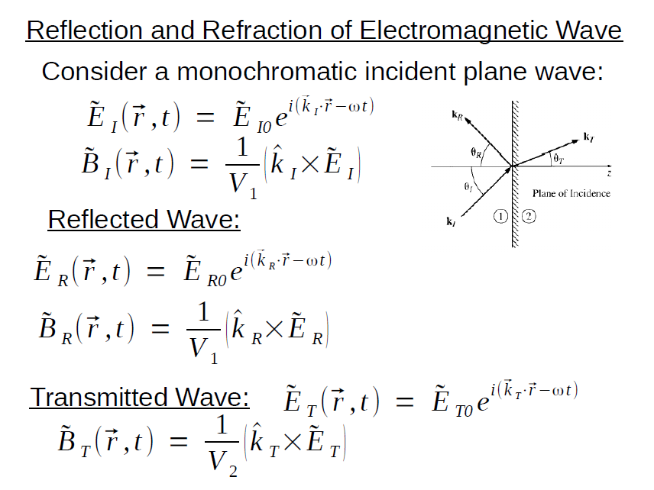

Slide 12
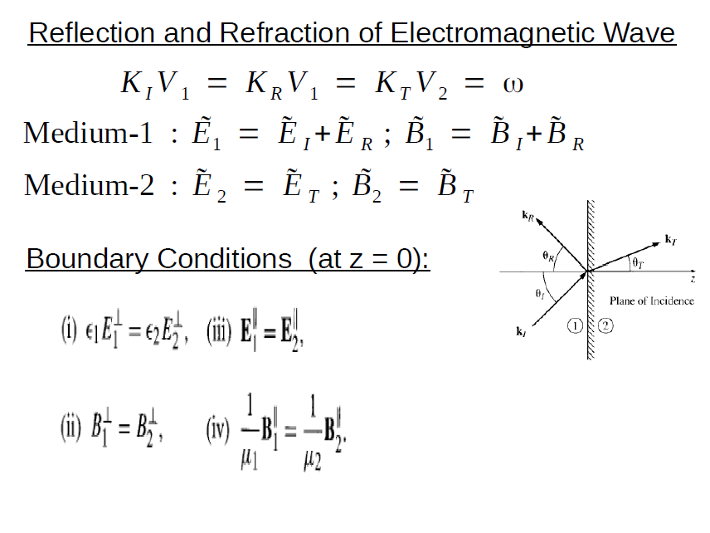

Slide 13
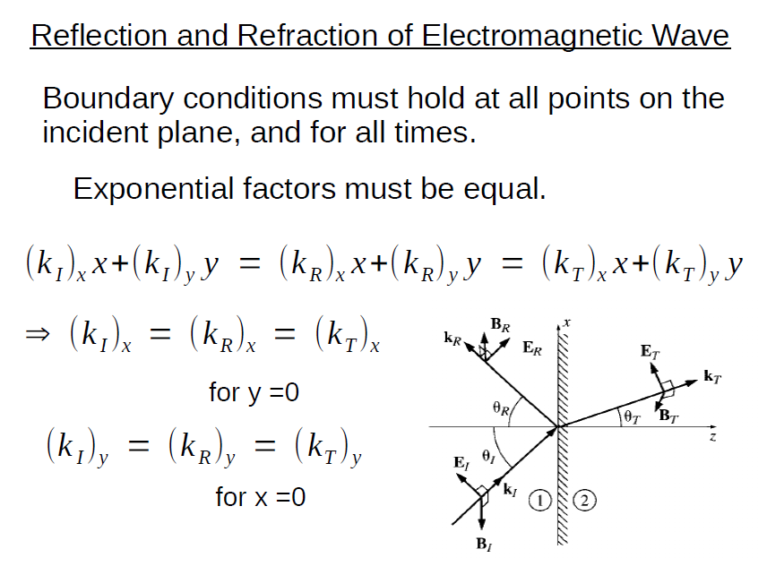

Slide 14
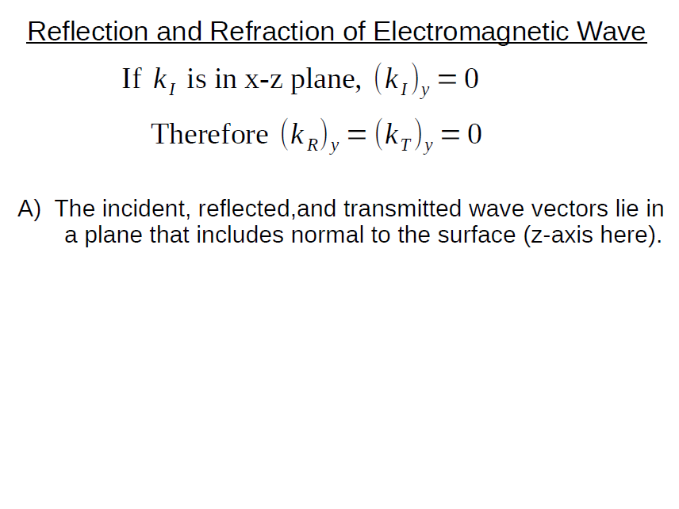

Slide 15
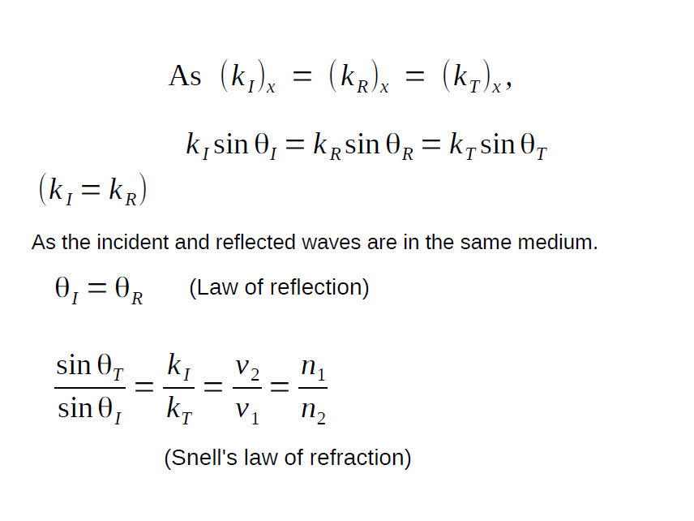

Slide 16

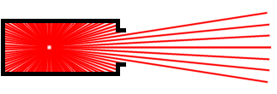
Coherence
A coherent light source emits waves in constant phase relation.
A perfectly coherent source is just a point-source.
Source: http://amasci.com/miscon/coherenc.html

Slide 17
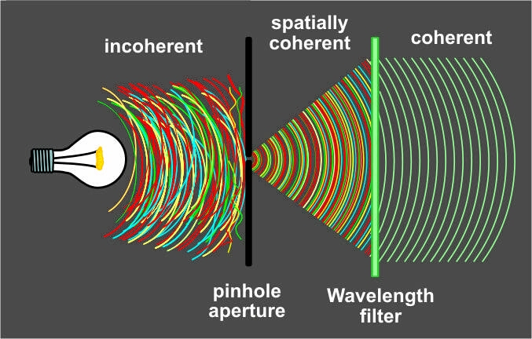
Coherence
In the discussion on optics, a monochromatic (single wavelength), coherent (spatial and temporal) source is assumed if not stated otherwise
Source: http://amasci.com/miscon/coherenc.html

Slide 18
Interference
Light waves interfere with each other much like mechanical waves do
All interference associated with light waves arises when the electromagnetic fields that constitute the individual waves combine
LINEAR SUPERPOSITION!
Resultant

Slide 19
Resultant of N waves

Slide 20
For N=2

Slide 21
Irradiance

Slide 23
The phase difference arising from a combined path length and initial phase difference.

Slide 24
For maximum irradiance
Total constructive interference

Slide 25
For minimum irradiance
Total destructive interference

Slide 26
For I₁=I₂

Slide 27
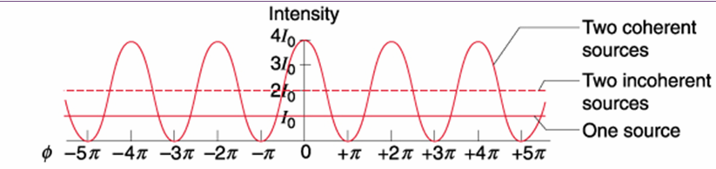

Slide 28
Phase difference

Slide 29
Optical path difference

Slide 30
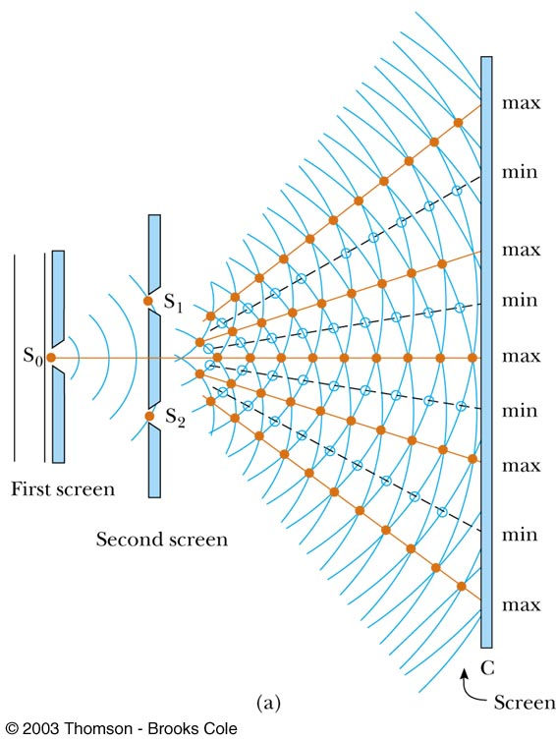
Young’s Double Slit Experiment

Slide 31
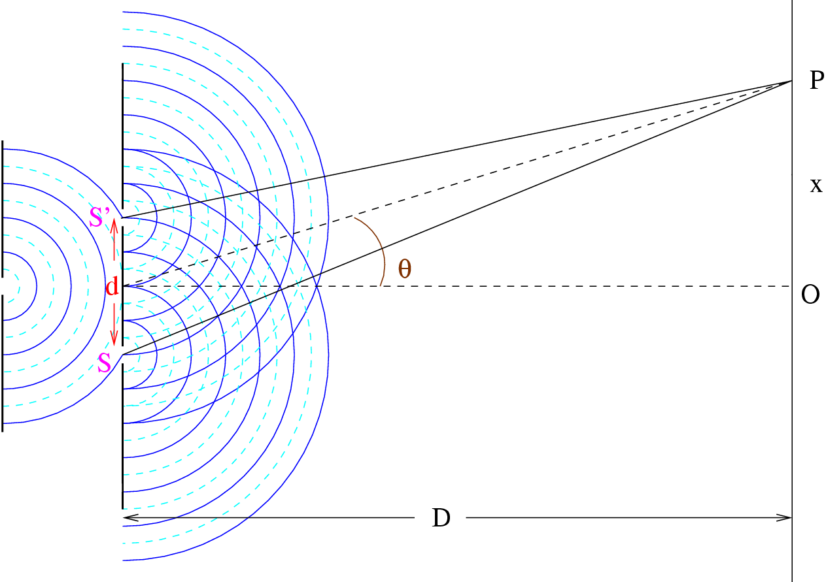
Young’s double slit
© SPK

Slide 32
Path difference:
For a bright fringe,
For a dark fringe,
m: any integer

Slide 33
For two beams of equal irradiance (I₀)
Visibility of the fringes (V)
Maximum and adjacent minimum of the fringe system

Slide 34
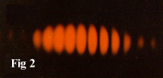
Photograph of real fringe pattern for Young’s double slit

Slide 35
Uses for Young’s Double Slit
Experiment
Young’s Double Slit Experiment provides a
method for measuring wavelength of the light
This experiment gave the wave model of light a
great deal of credibility.

Slide 36
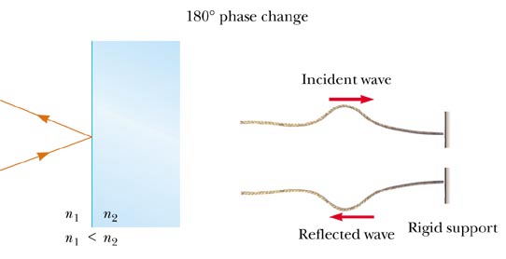
Phase Changes Due To Reflection
An electromagnetic wave undergoes a phase change of 180° upon reflection from a medium of higher index of refraction than the one in which it was traveling
Analogous to a reflected pulse on a string
μ₁
μ₂

Slide 37
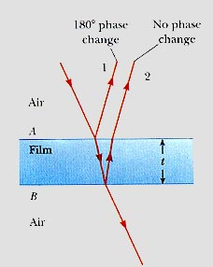
Phase shift

Slide 38
n₁
n_{f}
n₂
C
D
B
θ_{i}
θ_{t}
A
d

Slide 39
Optical path difference for the first two reflected beams

Slide 40
Condition for maxima
Condition for minima

Slide 41
Wedge between two plates
1
2
glass
t
D
glass
x
air
Path difference = 2t
Phase difference δ = 2kt - π (phase change for 2, but not for 1)
Maxima 2t = (m + ½) λ_{o}/n
Minima 2t = mλ_{o}/n

Slide 42
Newton’s Ring
Ray 1 undergoes a phase change of 180° on reflection, whereas ray 2 undergoes no phase change
R= radius of curvature of lens
r=radius of Newton’s ring

Slide 43
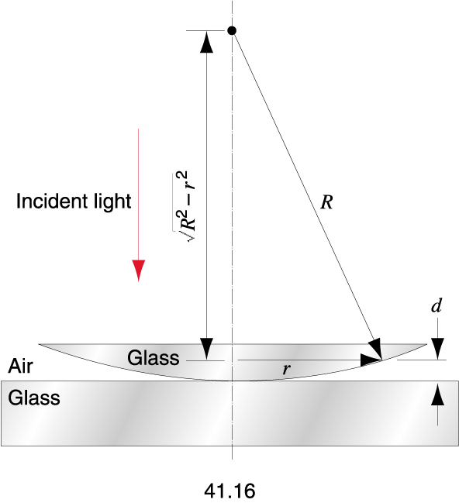

Slide 46
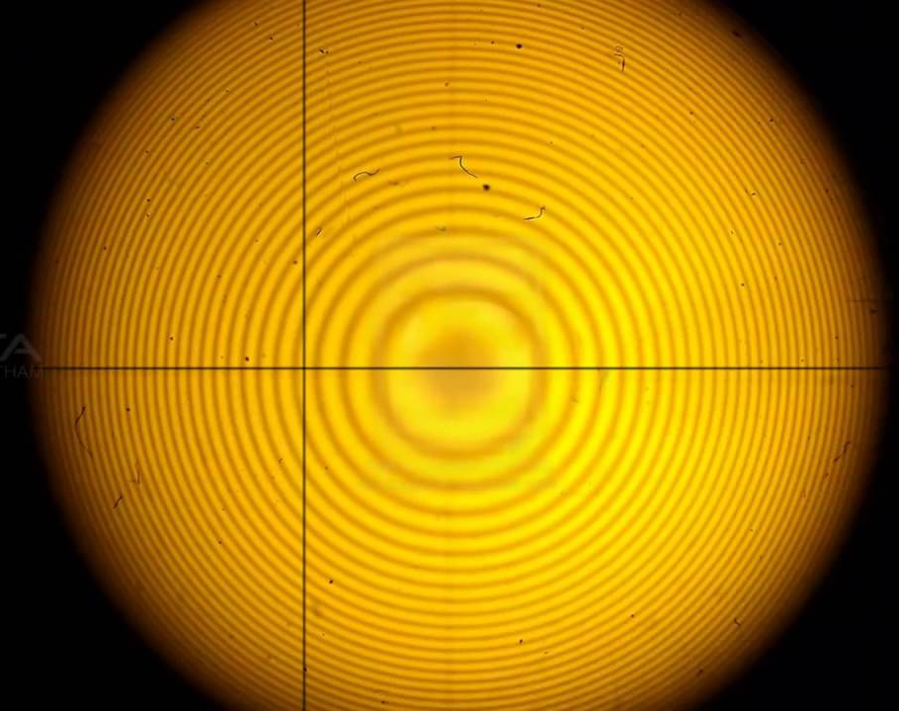
Reflected Newton’s Ring

Slide 47
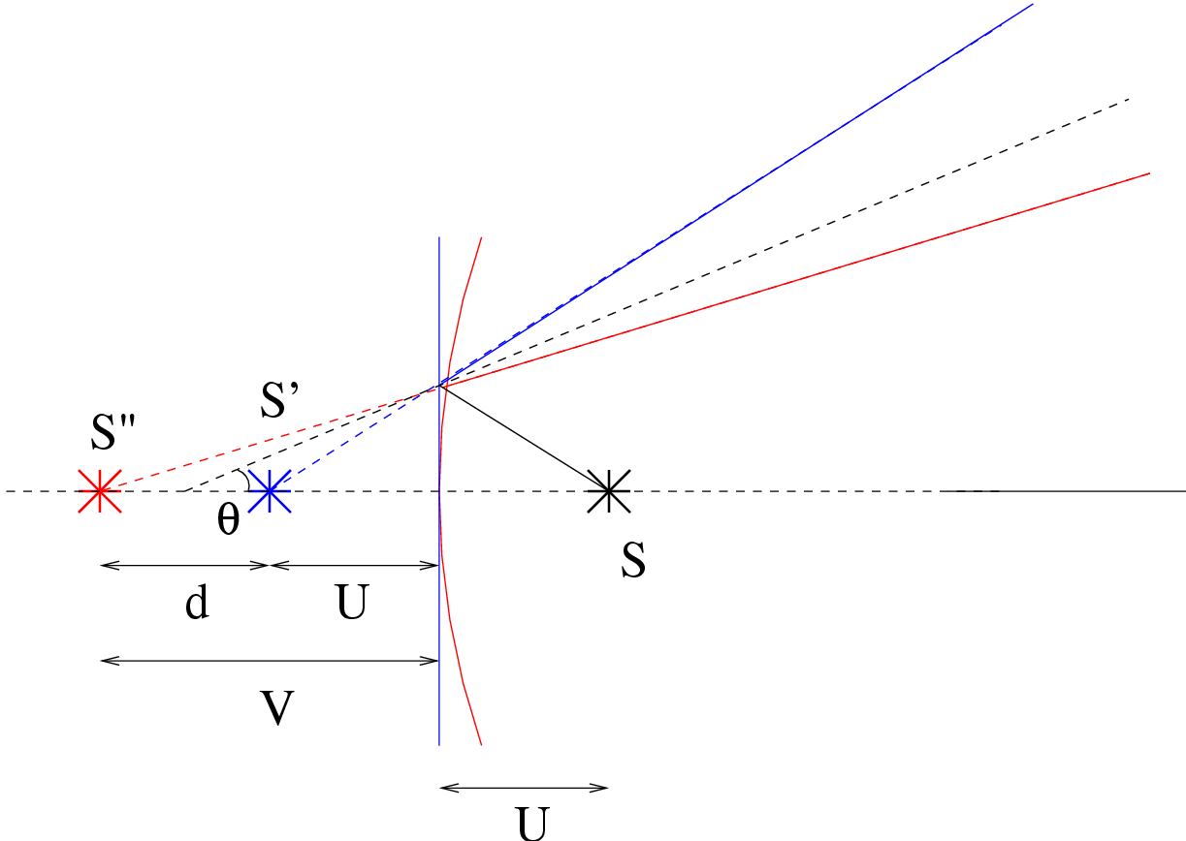
Newton’s Ring

Slide 48
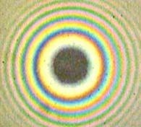
White light Newton’s Ring

Slide 49
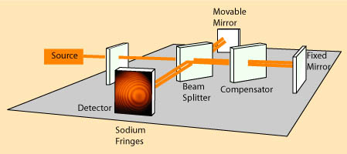
Michelson Interferometer
Experimental set up

Slide 50
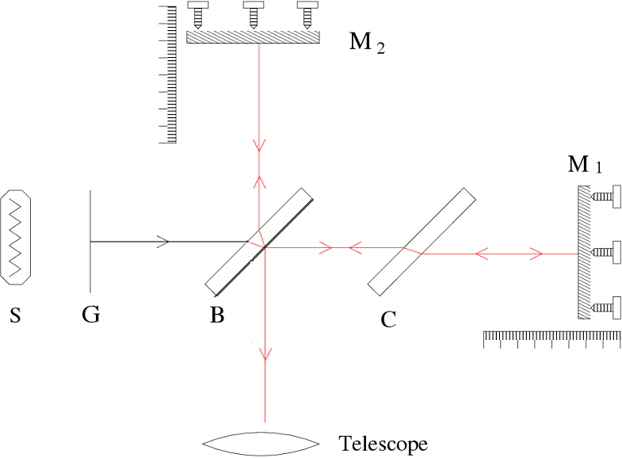

Slide 51
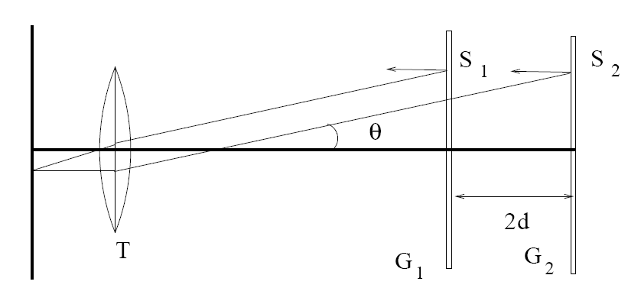

Slide 52
In Michelson interferometer
Radius of nth dark ring

Slide 53
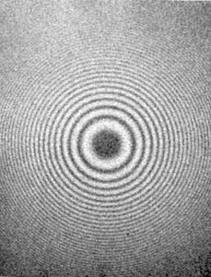
Order of the fringe
Angular radius of the pth ring
Formation of both real and virtual fringes

Slide 54
1. Measurement of wavelength of light

Slide 55
2. Measurement of wavelength separation
of a doublet

Slide 56

Concordance

Slide 57

Discordance
= (q+1/2)

Slide 58
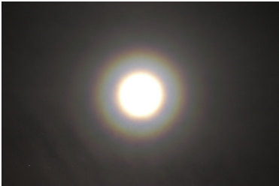
Diffraction

Slide 59
Huygens’s Principle
“Every point in a propagating wavefront serves as the source
of spherical secondary wavelets, such that the wavefront at some later time is the envelope of these wavelets.”
Huygens-Fresnel Principle
Every unobstructed point of a wavefront, at a given instant, serves as a
source of spherical secondary wavelets, The amplitude of the optical
field at any point beyond is the superposition of all these wavelets.

Slide 60
Classical model of diffraction
obstacle
wavefront
screen

Slide 61
On obstacle, the electron oscillator vibrating and reemittting at
source frequency
Incident field and field of all vibrating electrons superpose in such a
way that there is zero field beyond the obstacle.
Assume the mutual interaction between the oscillators are essentially
negligible.

Slide 62
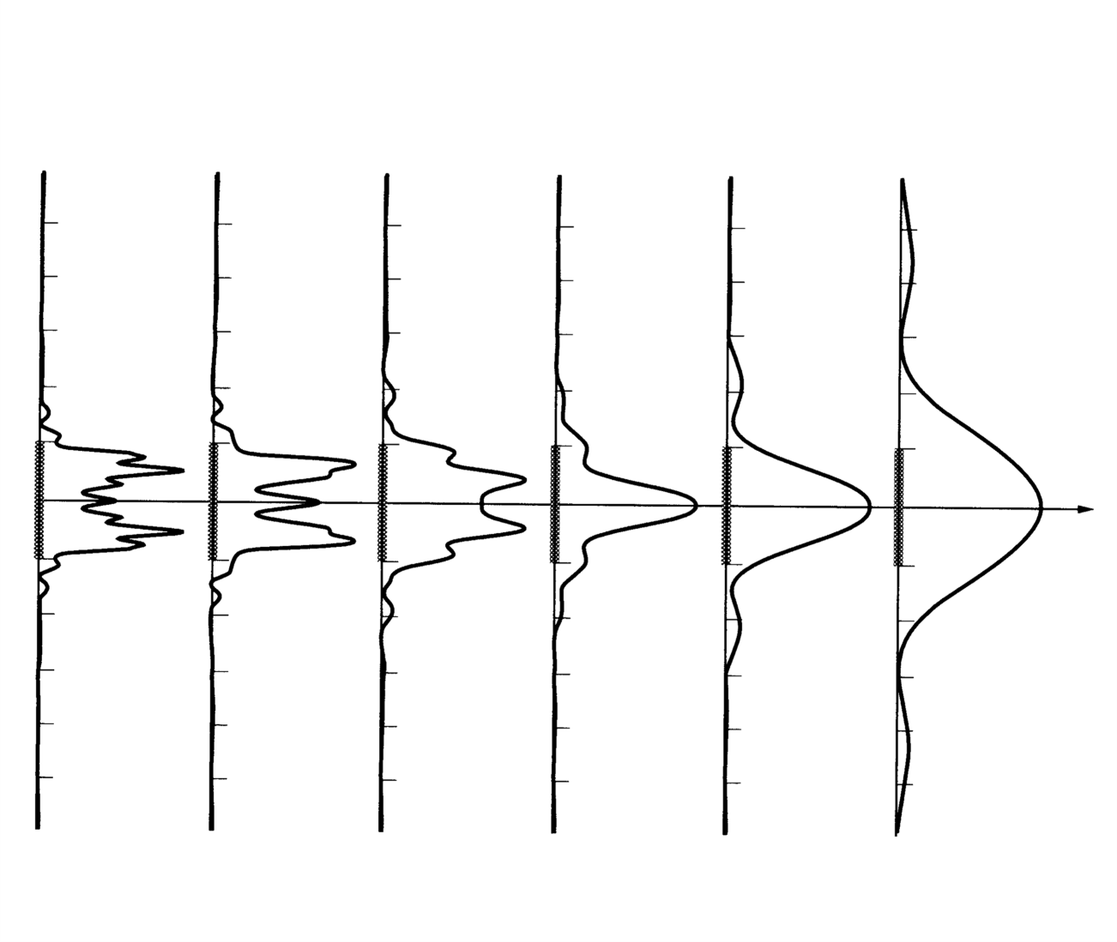
Fresnel –Fraunhofer Diffraction
Close to the slit
z
Far from the slit
Incident plane wave

Slide 63
Fraunhofer vs. Fresnel diffraction
In Fraunhofer diffraction, both incident and diffracted waves may be considered to be plane (i.e. both S and P are a large distance away)
If either S or P are close enough that wavefront curvature is not negligible, then we have Fresnel diffraction
S
S
P
P

Slide 64
If aperture (obstacle) has a width a
Fraunhofer limit diffraction
Fresnel limit diffraction
d is the smaller of the two distances from S and Σ and P

Slide 65
Fresnel diffraction pattern does change in shape as we move further away from the object (until, of course, we are so far away that the Fraunhofer condition is satisfied).
Fraunhofer or far field diffraction
Fresnel or near field diffraction

Slide 66
Fraunhofer Diffraction
Single Slit
Diffraction by coherent line source

Slide 67
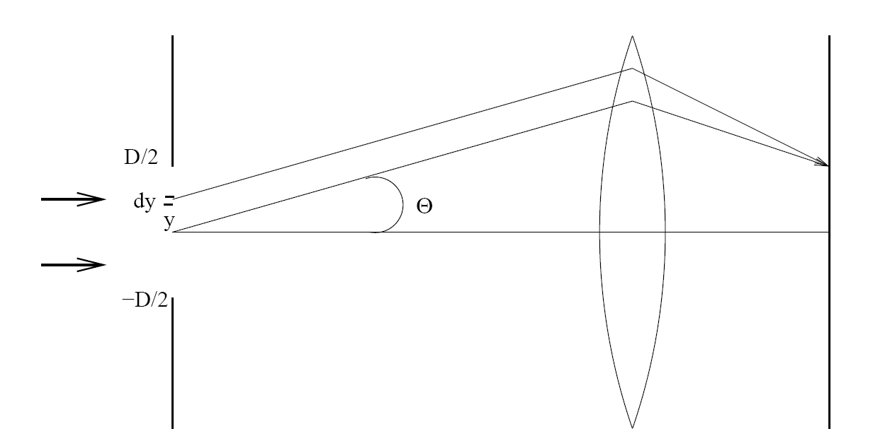
A Coherent Line Source

Slide 68
Total radiation at an angle θ due to the line element dy
Net field at an angle θ

Slide 69
Irradiance

Slide 70
For Principal maxima

Slide 71
For minima

Slide 72
For extrema of I(θ)

Slide 73
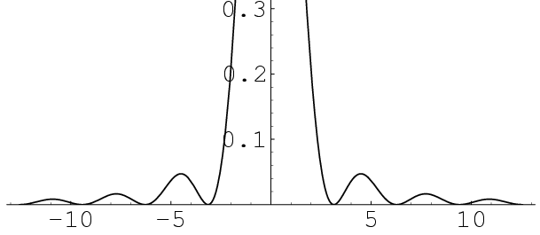
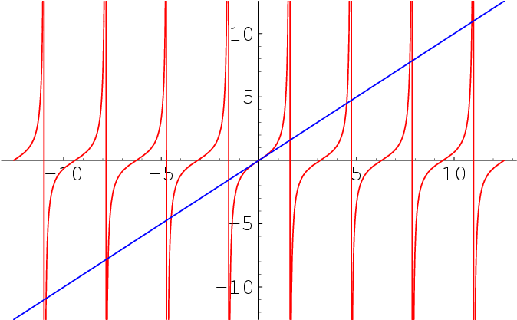
Subsidary Maxima
tan β = β
f₁(β)=tanβ
f₂(β)=β
β

Slide 74
For subsidiary maxima

Slide 75
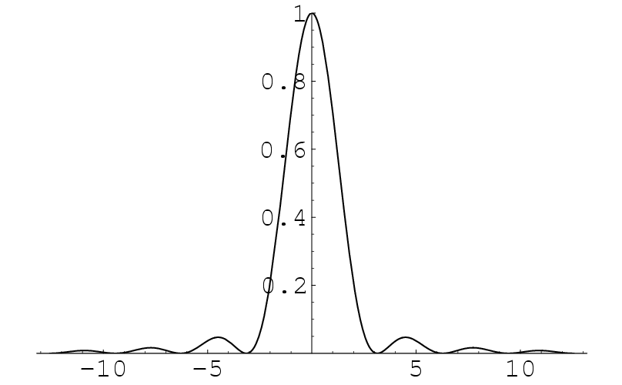
Intensity for single slit
β = π b Sin θ / λ
Maxima at
I
Minima at
tan β = β
β = + m π
_
m = 1, 2, 3…
β

Slide 76
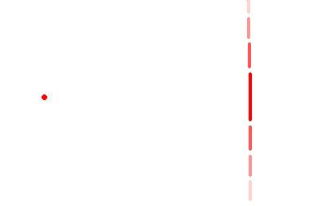
Half width of central maximum
= λ / b
Diffraction envelope size
Δ x0 = 2f λ / b
Δ x0
Point source
Smearing effect
of diffraction

Slide 77
Double slit diffraction

Slide 78
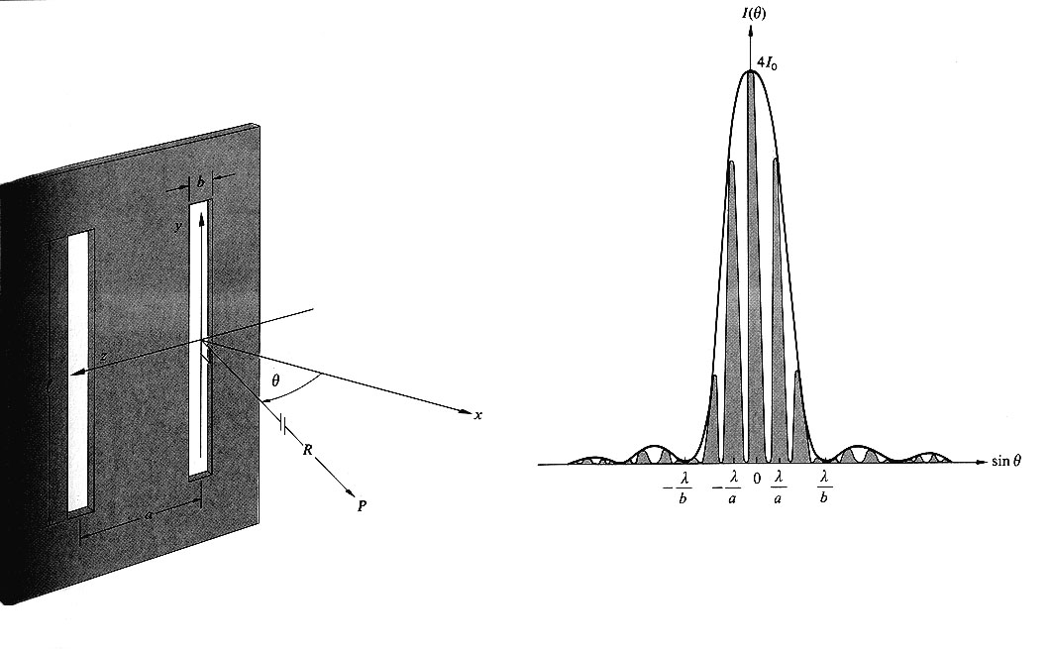
b
z
a

Slide 79
Total contribution of the electric field

Slide 80
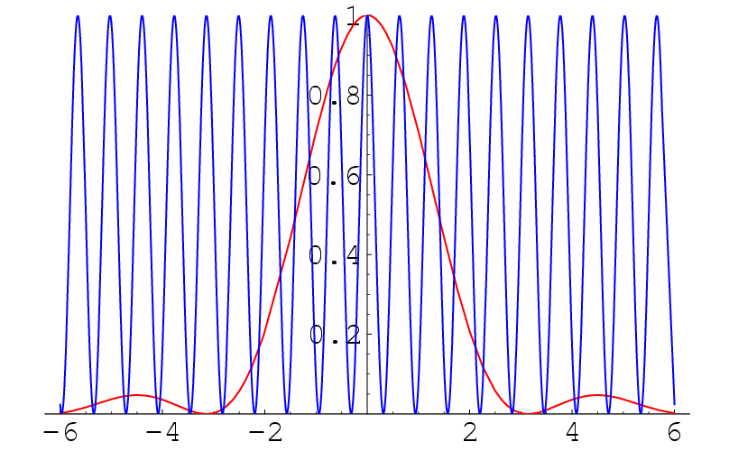
Single slit diffraction pattern × double slit interference pattern
© SPK

Slide 81
Irradiance at point P

Slide 84
3π

Slide 85
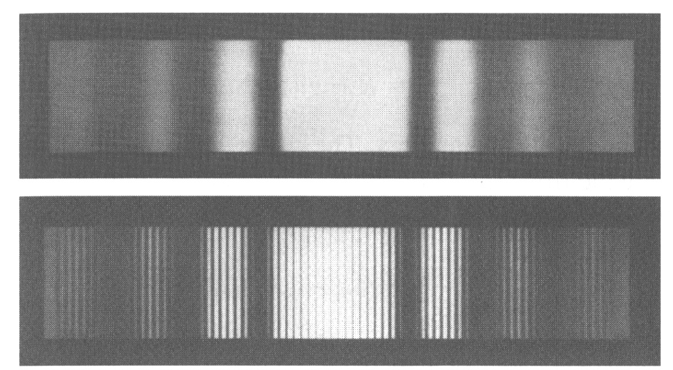
Diffraction from one- and two-slit screens
One slit
Two slits

Slide 86
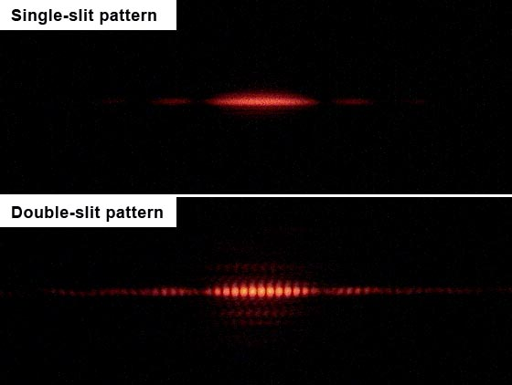

Slide 87
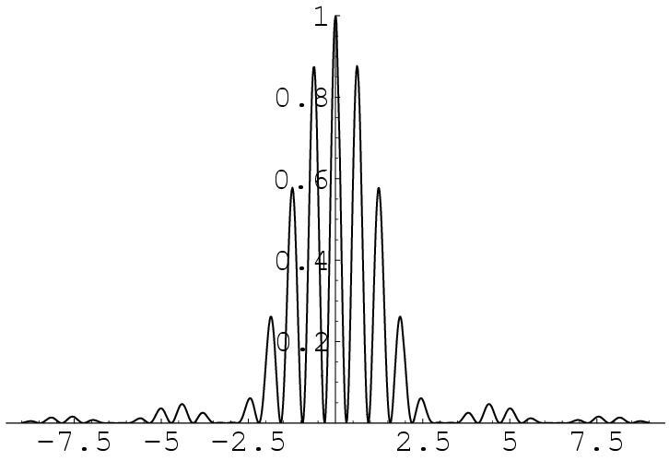
Missing orders 5, 10, 15, 20….
Minima at
a/b = 5
b Sin θ = m λ
m ≠ 0
Maxima at
a Sin θ = n λ

Slide 88
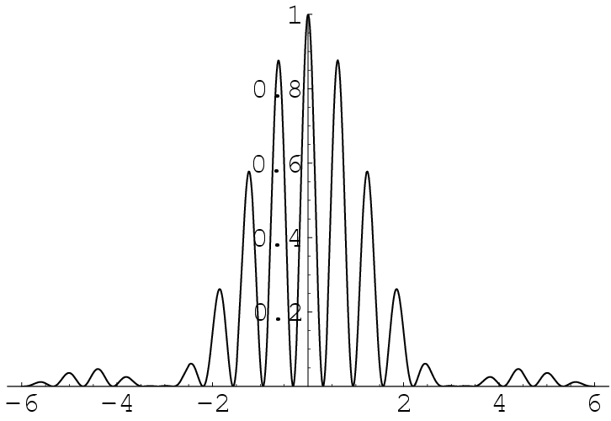
Double slit intensity pattern for a=5b
©SPK

Slide 89
When we use the double-source equation to find locations of bright spots, we find that there are some places where we expect to see bright spots, but we see no light. This is known as a missing order, and it happens because at that location there's a zero in the single slit pattern.

Slide 90
Remember!
If the zero in the single slit pattern, and a zero in the double slit pattern coincides, it is not called a missing order .. for, there is no order to be missing!
Also, if there is a local peak in the single slit pattern, and a zero in the double source pattern, there will still be a zero (remember, we multiply the functions!) - this also is not a missing order.

Slide 91
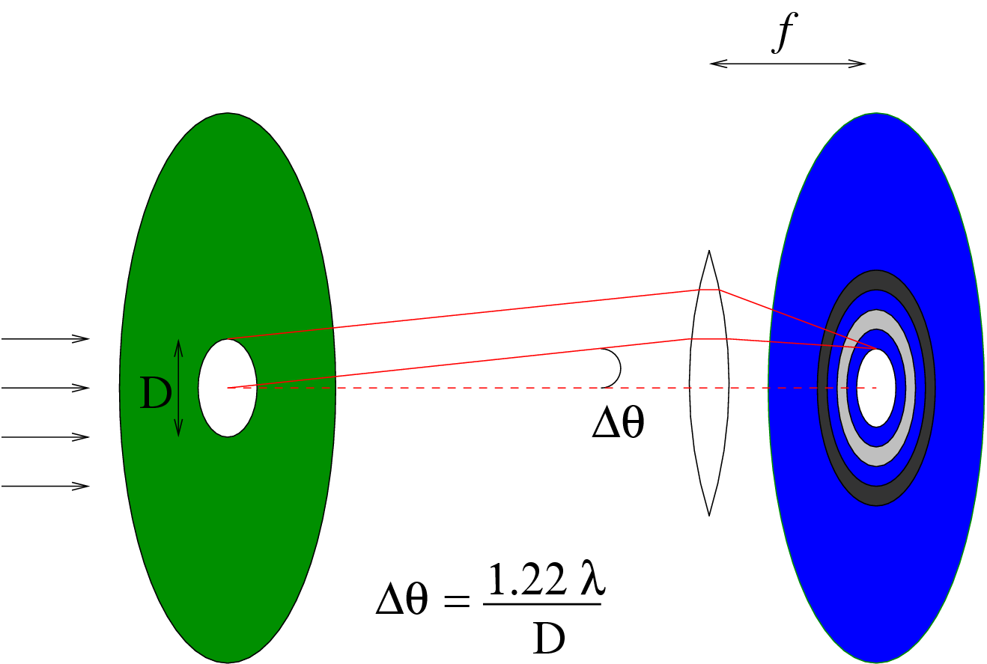
Circular aperture
q
a
R

Slide 92
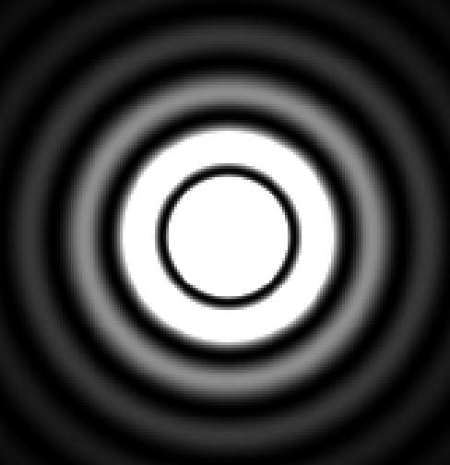
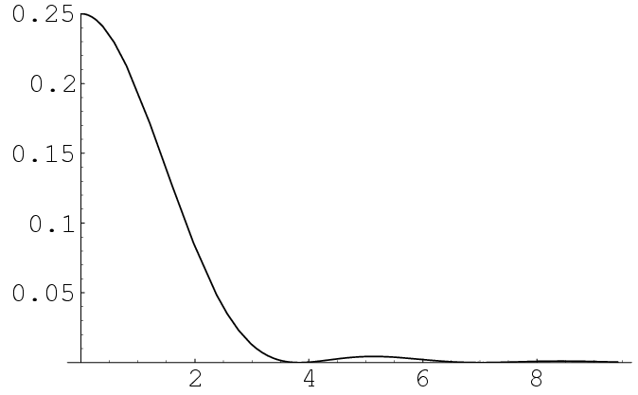
I = I0 [2 J1(γ) / γ]
γ =k a Sinθ
[ J1(γ) / γ]
J₁=Bessel function
of order 1
3.83
γ

